Slide 1
BCA CAPSTONE PROJECT (Review III) BRAIN TUMOR DETECTION
Submitted to the Presidency University, Bengaluru in partial fulfillment for the award of the degree of Bachelor of Computer Applications(BCA)
Project Team No :38
Under the supervision of
Dr. Raja Jitendra Nayaka Assistant Professor, Selection Grade
Name | Roll Number
Dhruv Pahal | 20231BCA0260
Vikas V | 20231BCA0262
Bhargav Deekshith | 20231BCA0250
Vaishnavi Satish | 20231BCA0267

Slide 2
Content
Project Overview
Modular design
Timeline of the Project
Progress Update & Github Link
Team Member Contributions

Slide 3
Project Overview
Project Goal: The goal of this project is to develop an efficient machine learning-based brain tumor detection system using MRI scans. By leveraging deep learning techniques such as Convolutional Neural Networks (CNNs), the model aims to accurately classify MRI images into tumor and non-tumor cases, assisting in early diagnosis and improving patient outcomes.
Project Problem: Brain tumors are a critical health concern, requiring early and precise detection for effective treatment. Traditional diagnostic methods are time-consuming and prone to human error. This project addresses the challenge of automating brain tumor detection using machine learning algorithms to analyze MRI scans, improving diagnostic accuracy and reducing the workload of radiologists. The proposed system aims to enhance efficiency, reliability, and accessibility in tumor diagnosis.
Scope of the Project: This project focuses on automated brain tumor detection using machine learning techniques applied to MRI images. It includes data collection, preprocessing, feature extraction, model training, and classification using deep learning algorithms like CNNs. The system will be evaluated based on accuracy, precision, recall, and F1-score.

Slide 4
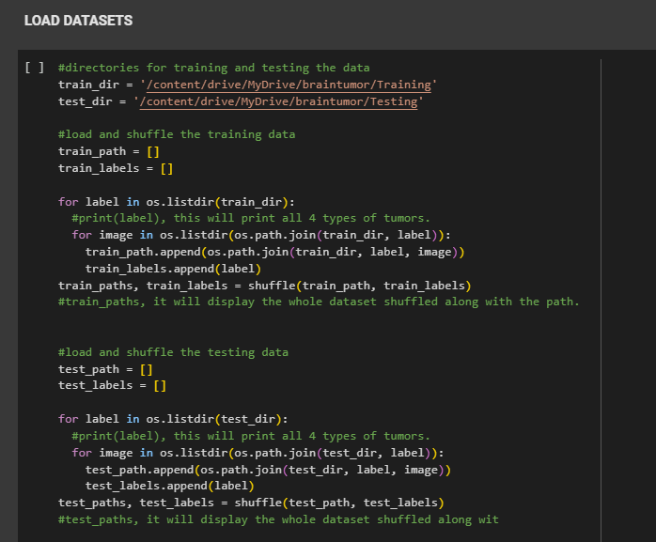
Module Design
Modular Breakdown
MODULE 1: DATA COLLECTION
The dataset used for this project “brain tumor detection” is taken fromm a public site Kaggle and it was uploaded and divided into “test” and “training “ datas.

Slide 5
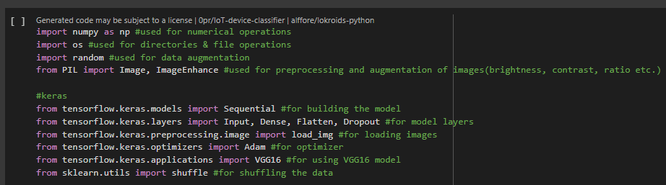
Module Design
LIBRARIES USED:
Various libraries are used in this project for various functions throughout the project. Some main libraries are: NUMPY, KERAS, MATPLOTLIB etc.
Their working is explain as follows:

Slide 6
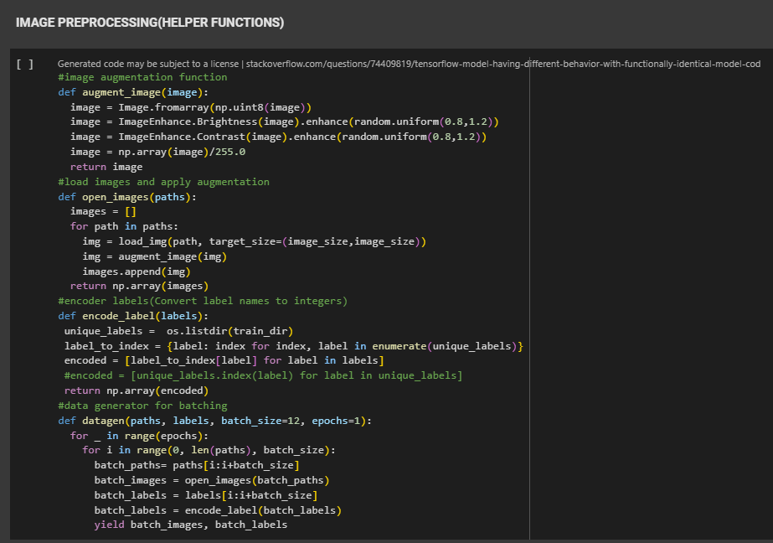
Module Design
MODULE 2: DATA PROCESSING
Various functions are used to help build this project and process the data as per our requirements for eg-: size, augmentations, labels, batching etc.

Slide 7
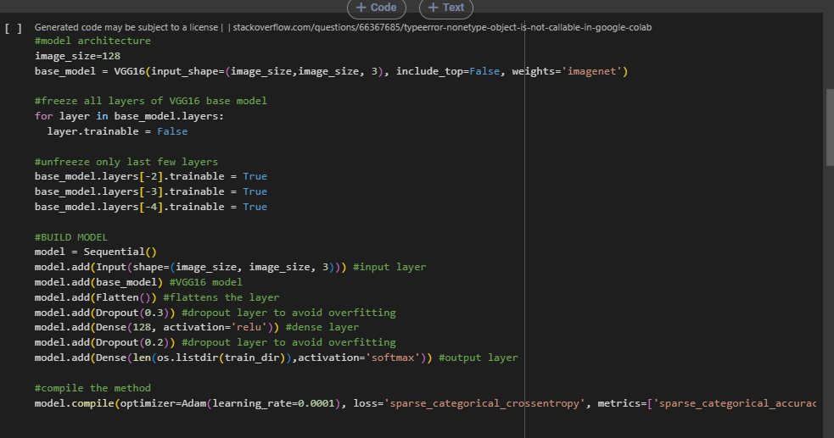
Module Design
MODULE 3: TRAINING THE MODEL
This project is made using transfer learning where a pre-trained model VGG16 is used on the dataset for image processing and it’s knowledge is used based on “imagenet” dataset for better and accurate results.

Slide 8
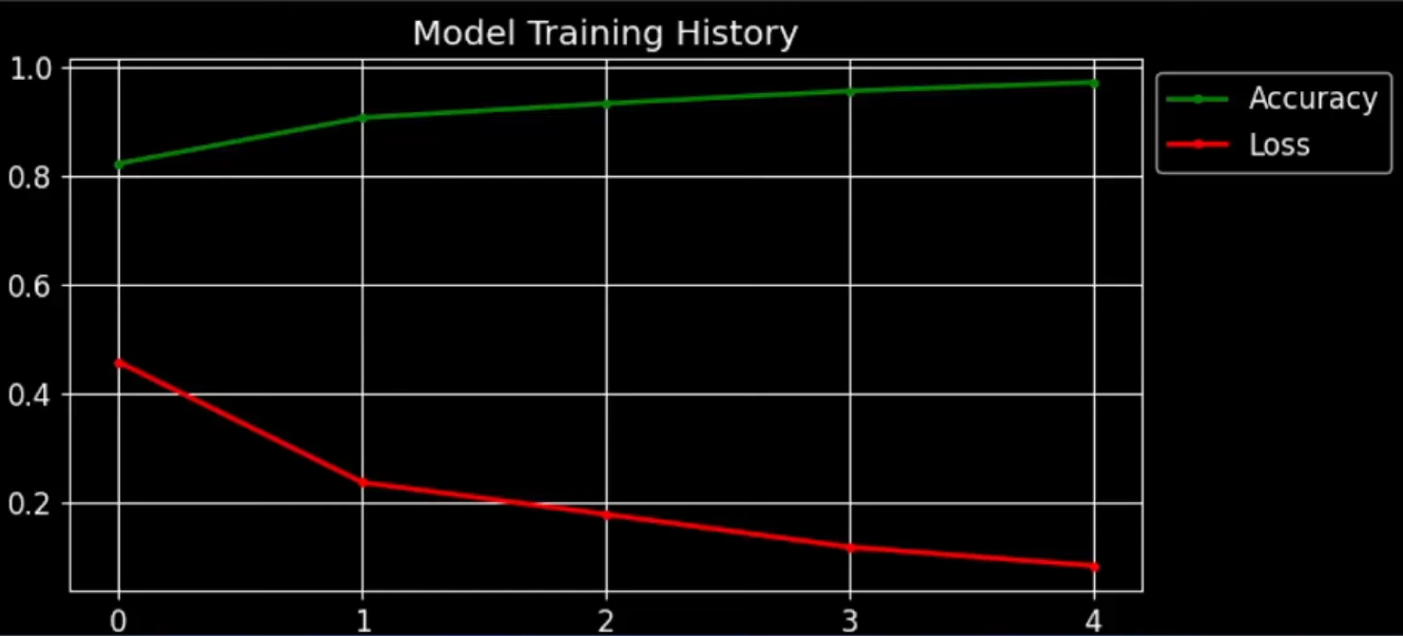
Module Design
MODULE 4: ANALYSIS AND RESULTS
After the project is done, we’ll run various performance tests on this for eg: ‘Accuracy, loss curve’, ‘classification report’, ‘confusion matrix’.

Slide 9
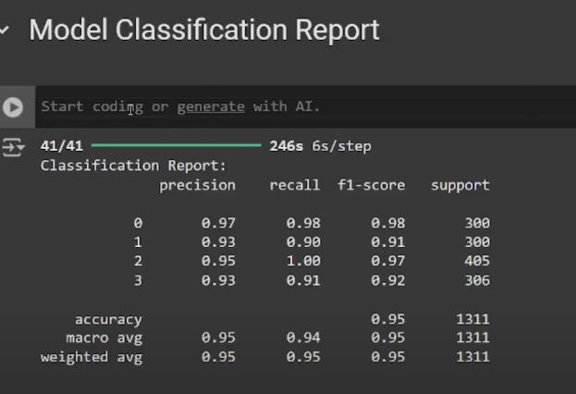
Module Design
MODULE 4: ANALYSIS AND RESULTS
After the project is done, we’ll run various performance tests on this for eg: ‘Accuracy, loss curve’, ‘classification report’, ‘confusion matrix’.

Slide 10
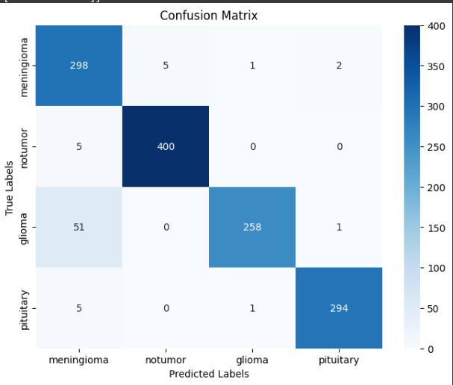
Module Design
MODULE 4: ANALYSIS AND RESULTS
After the project is done, we’ll run various performance tests on this for eg: ‘Accuracy, loss curve’, ‘classification report’, ‘confusion matrix’.

Slide 11
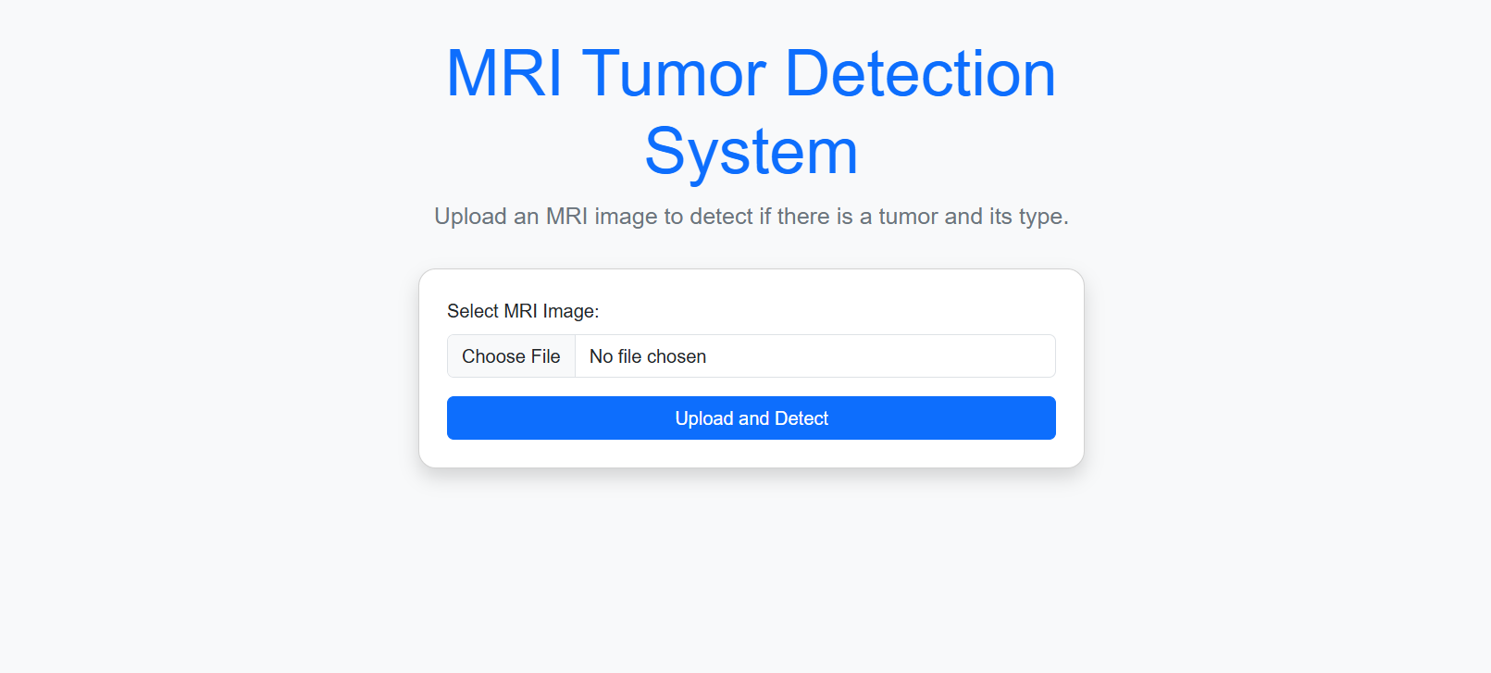
Module Design
MODULE 5: FRONT END DEVELOPMENT
We’ve used Pycharm for frontend and backend development and have launched a webpage on the local host.

Slide 12
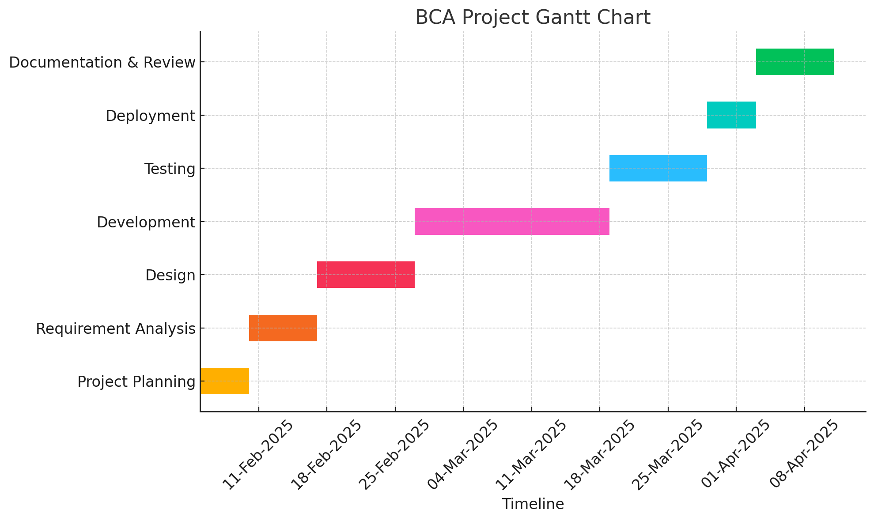
Timeline of the Project (Gantt Chart)
The purpose of this slide is to illustrate the project's adherence to the designated timeline
Clearly outline the work that still needs to be done.

Slide 13
Progress Update & Github Link
Github link:- https://github.com/dhruv-pahal/BrainTumorDetection.git
Progress update-: back-end programming is done, whole model is ready on google colab.

Slide 14
Team Member Contributions
Team Member | Contribution
A. Dhruv Pahal(20231BCA0260) | Frontend & Backend
B. Vikas V(20231BCA0262) | Resources & Research
C. Bhargav Deekshith(20231BCA0250) | Frontend & Backend
D. Vaishnavi Satish(20231BCA0267) | Resources & Research

Slide 15


